Slide 1



Tiger Analytics PPI Cross-Selling Prediction Case Study
COLLEGE : MBA IIT KANPUR
PRESENTED BY:
Krunal Kshirsagar

Slide 2
EXECUTIVE SUMMARY
OBJECTIVES
01
The purpose of classification is to predict who should the bank approach to cross-sell PPI and which type of PPI supposed to be cross-sold
OUTCOME
02
Using the data analytics and modelling, we were able to predict which customers should we target to cross-sell PPI and what type of PPI should be cross-sold to him
IMPLEMENTATION
03
Analysis of dataset and Creation of model which can segment customers for PPI cross selling and predict which type of PPI to sell with as much high accuracy as possible

Slide 3
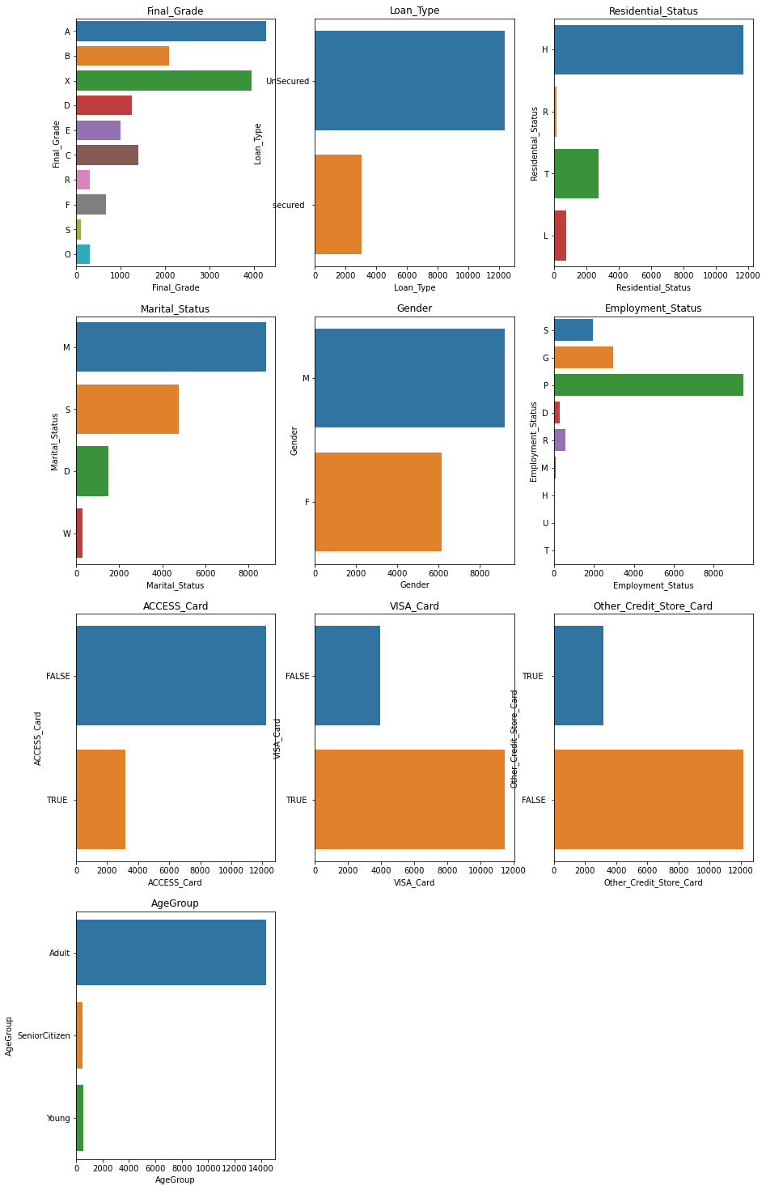
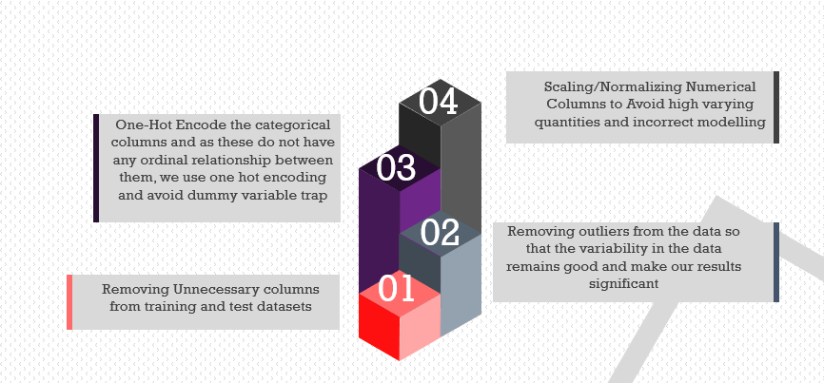
EDA and Data Preprocessing
Some data variables were heavily distributed over a single category. We got rid of unimportant variables.
Age field had some negative values. After getting rid of those, we divided Age into 3 categories. The people above 65 age are less likely to buy PPI, so we removed those.
Some Variables were not making sense logically to include in the dataset, so we got rid of them.
Some variables were highly skewed, and had loose correlation with dependent variable, so we decided to drop them.

Slide 4
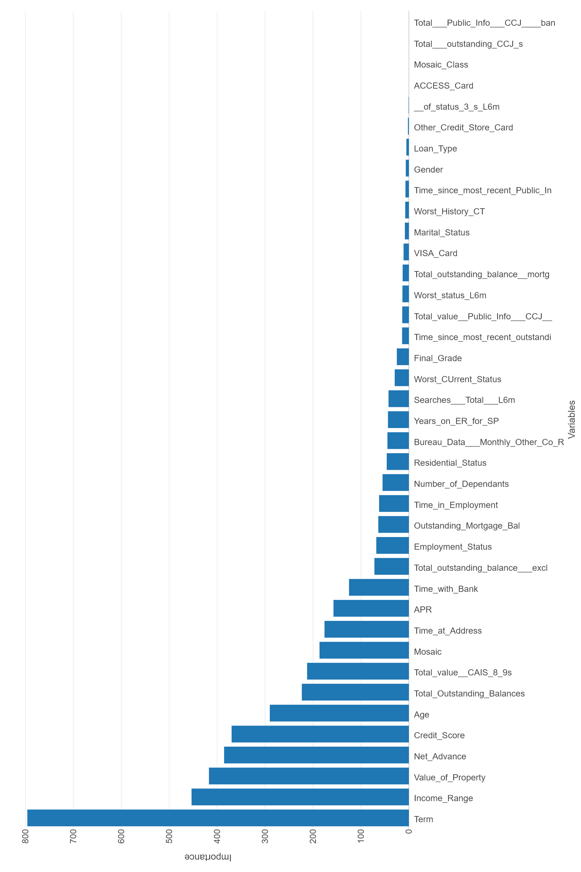
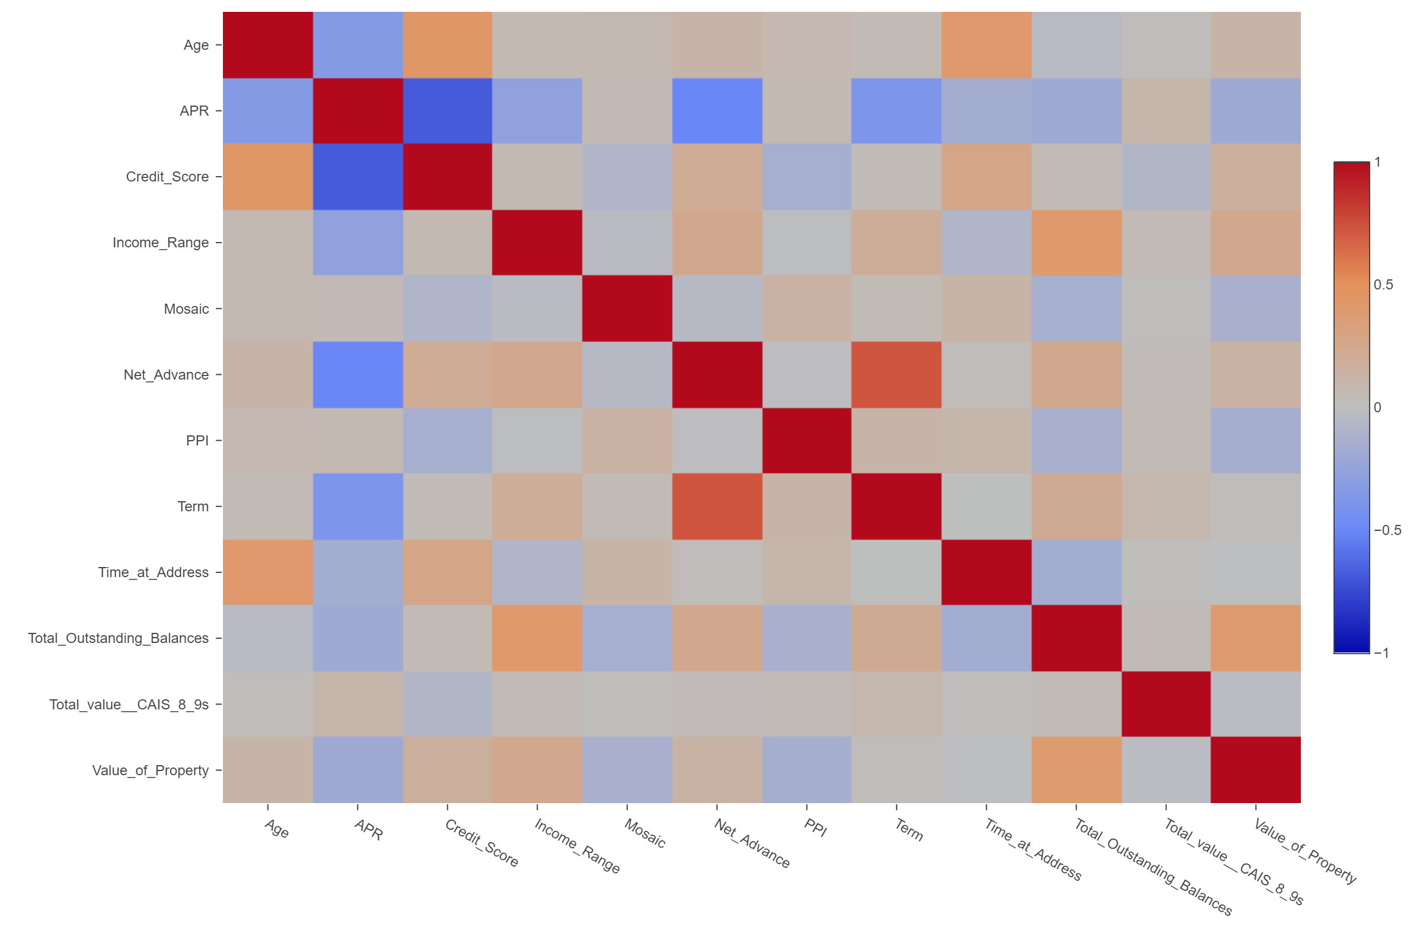
Feature Importance
After doing Exploratory Data Analysis, many fields were deleted for their redundancy in the dataset as discussed in previous slide
However, Still 42 independent fields were remaining which showed variability in dataset
To find out the important fields which were affecting the dependent variable, feature importance was used
Feature important showed how different independent variables affected dependent variable
Correlation matric came in handy to see which of these variables were highly correlated to the PPI variable
Finally, few important independent variables were selected to train the model

Slide 5
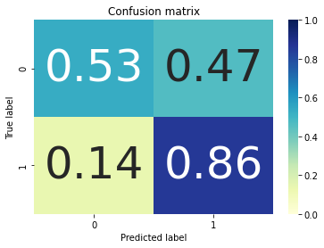
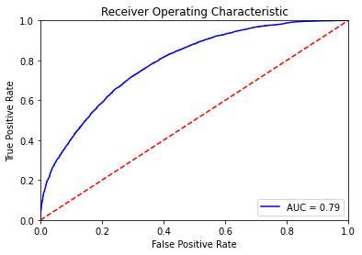
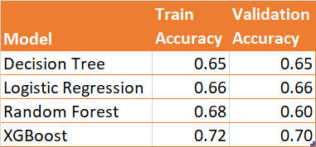

MODELLING
The preprocessed data for the project was then divided into training and validation data 4:1 ratio, to understand the accuracy of the models
To further validate models, metrics such as sensitivity, specificity, f1score, AUC ROC curve were used
After performing Hyper Parameter tuning the XGBoost model gave highest accuracy on train 0.72 and on validation 0.70
XG Boost Model was chosen as final model
This model is used on Test dataset to generate the outcome variable ‘PPI‘, which told us the leads to cross-sell PPI

Slide 6
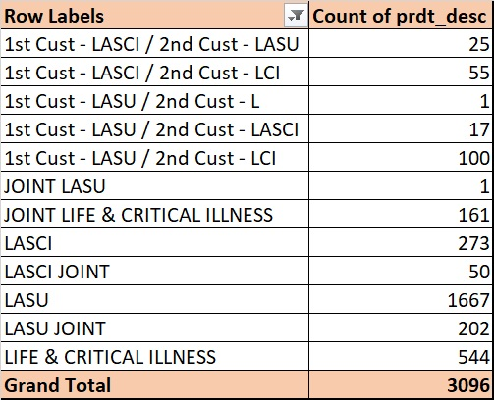
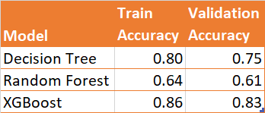
Product selection for cross selling
For this analysis we considered Product Description (prdt_desc) as dependent variable, and done multiclass classification on train data to check for the accuracy of the model and then determined the communication channel on test data
The XGBoost classifier worked great over here and provided highest accuracy of 0.86 for train data and for validation data accuracy of 0.83 was observed

Slide 7
CONCLUSION
B
Get rid of the illogical and inconsistent data points to get as much accuracy as possible
C
Perform modelling using different classifiers and do cross validation to get high accuracy
A
Focus on the factors showing high correlation with PPI like Credit_Score, Value_Of_Property, etc.
After implementing all the models, we saw that the model that gave the best performance was XGBoost Classifier with RandomizedSearchCV .
D

Slide 8
THANK YOU

